Slide 1

KKR&KSR INSTITUTE OF TECHNOLOGY AND SCIENCES
(Approved by AICTE, Permanently Affiliated to JNTU Kakinada, Accredited by NBA & Accredited by NAAC 'A'Grade,
Vinjanampadu (V) Vatticherukuru (M), Guntur (DT) – 522017)
DEPARTMENT OF INFORMATION TECHNOLOGY
REVIEW 2
IMAGE GENERATION WITH STYLE TRANSFER
PROJECT TEAM:
20JR1A1242
20JR1A1259
20JR1A1261
20JR1A1266
PROJECT GUIDE:
B.NAGAESWARI
ASSISTANT PROFESSOR

Slide 2
MODULE DESIGN SPECIFICATIONS:-
The modules which are used to develop the Image Generation With Style Transfer
They are
1.User interface module
2.Content Image processing module
3.Style Image processing module
4.Output generation module

Slide 3
User interface module
The User Interface module is responsible for the interaction between the user and web interface
Components used:-
1. Streamlit(Streamlit is used to create the web application and user interface)
2. Streamlit_Option_menu(This module provides different options for the user each option defines as as one web page.)

Slide 4
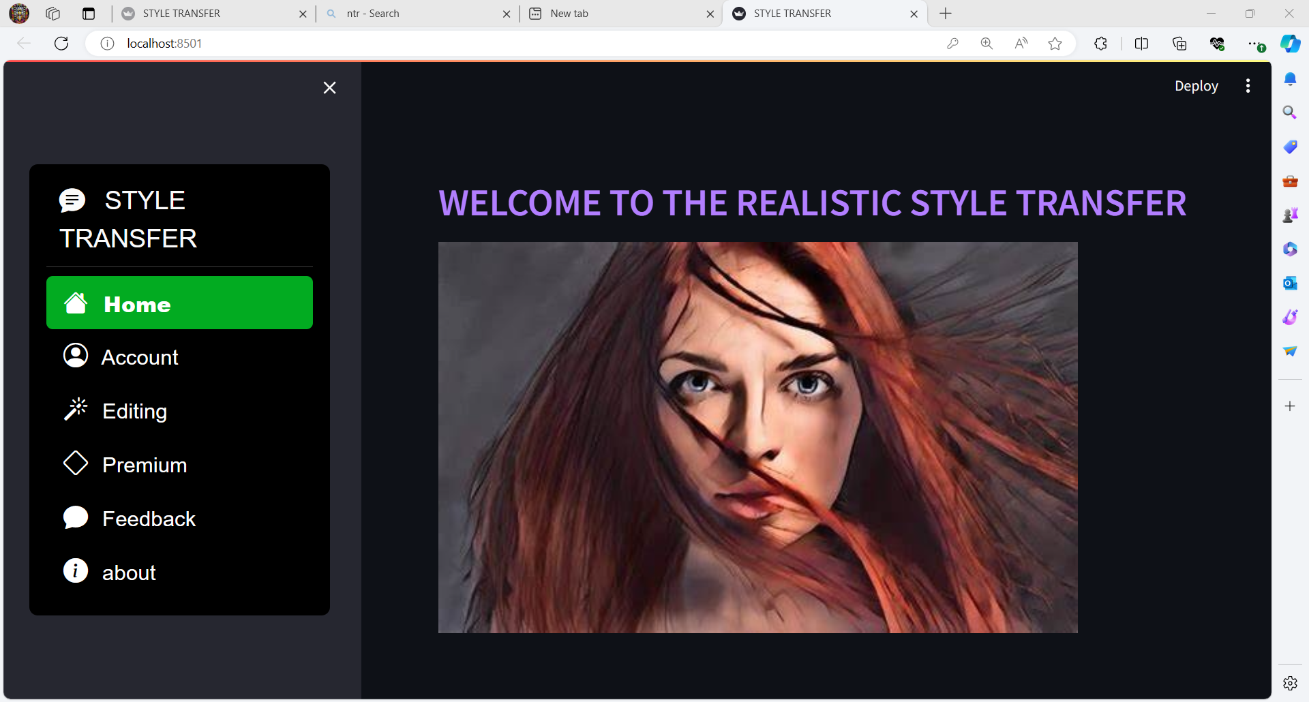
User interface module:-

Slide 5

Streamlit_option_menu
Each option defines a individual web page

Slide 6
Content image processing module
The content image Processing module handles the content image where the user can upload the image from the local browser.
Components used:-
1. File_uploader
2. content_temp_location
3. Load_image
4. Image

Slide 7
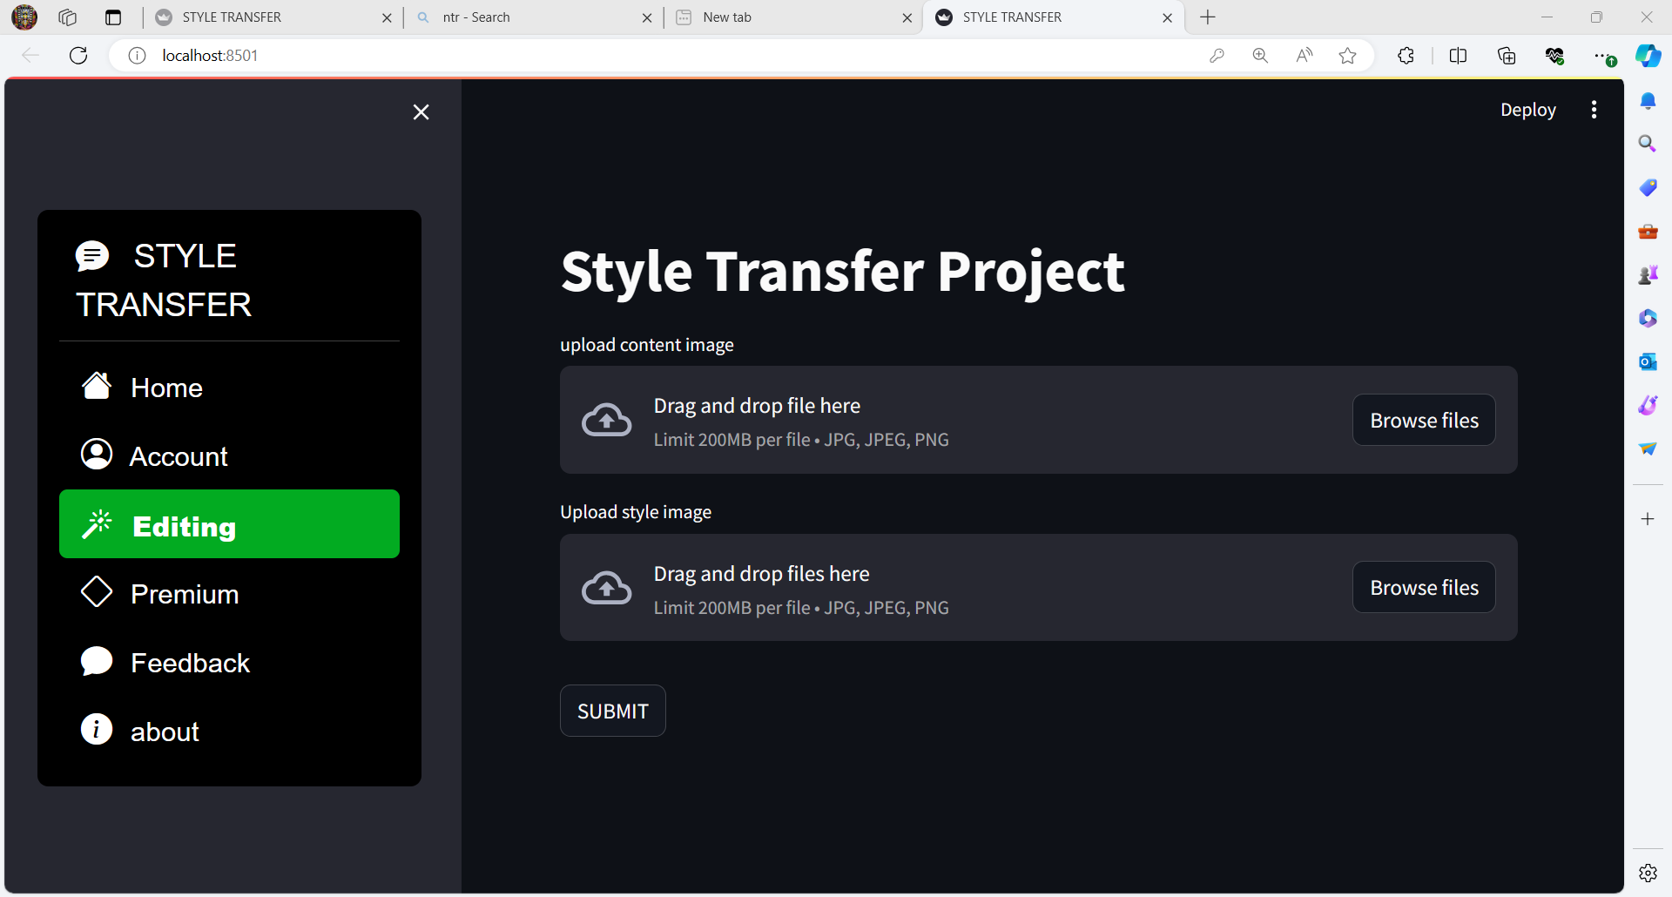
File_uploader

Slide 8
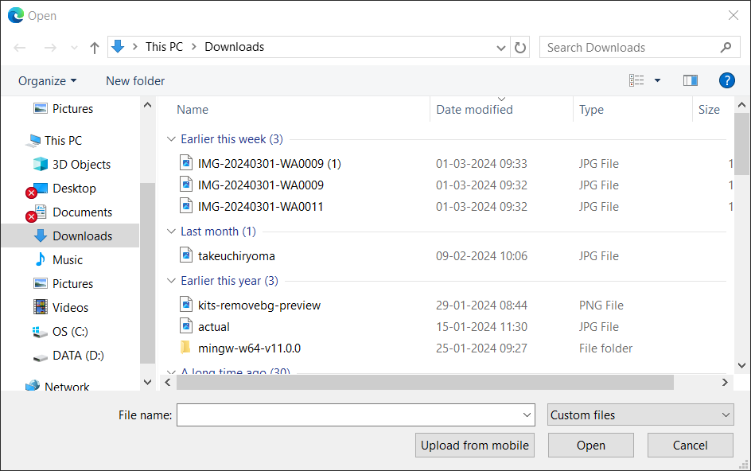

Slide 9
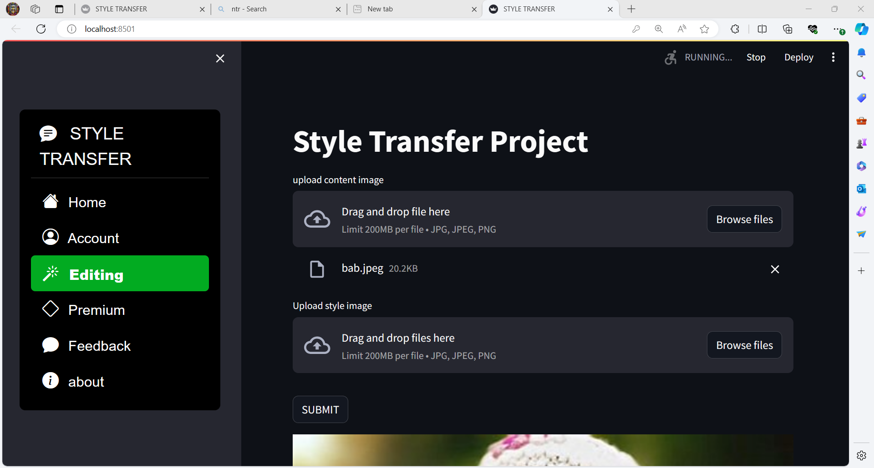

Slide 10
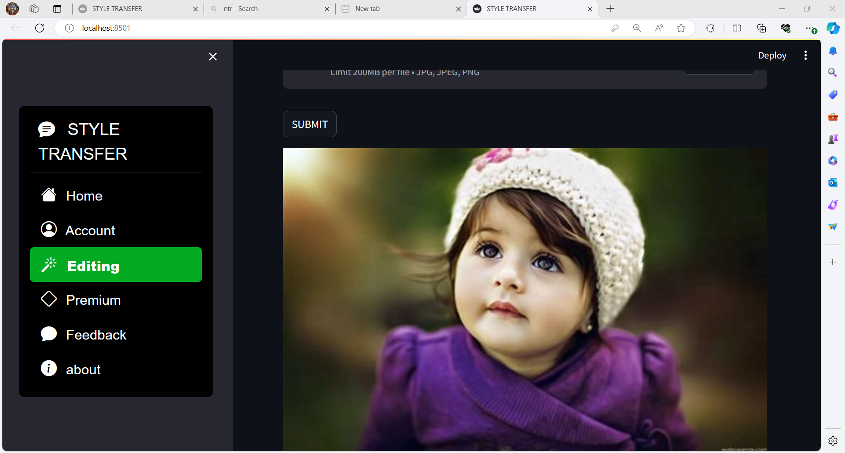

Slide 11
Style image processing module
The Style image Processing module handles the style image where the user can upload the image from the local browser .
Components used:-
1. File_uploader
2. content_temp_location
3. Load_image
4. Image

Slide 12
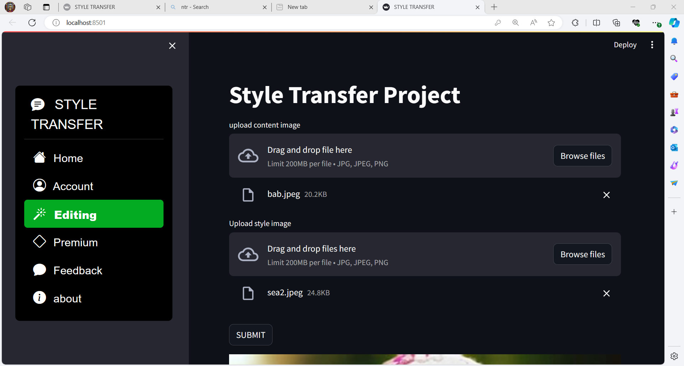

Slide 13
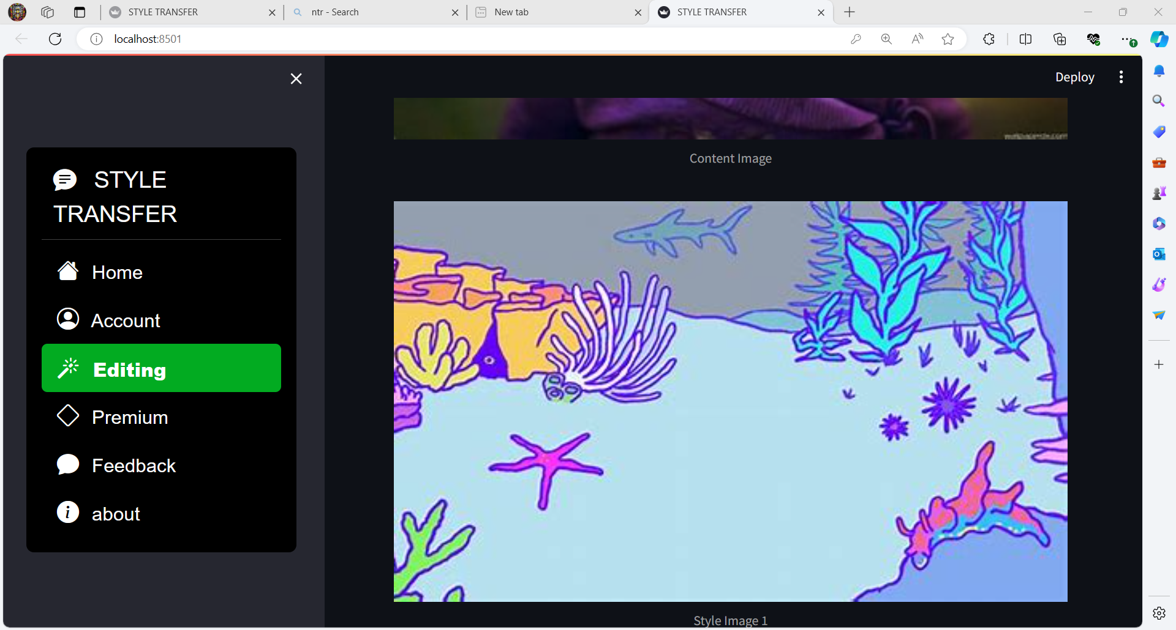

Slide 14
Output processing module:
The output processing module generates stylished image based on user uploaded style image.
Components used:-
1. Hub(process the model that converts the content into stylished image based upon the training data)
2. Validators(validators is a simple function that takes the value to validate and possibly some additional key-value arguments )

Slide 15
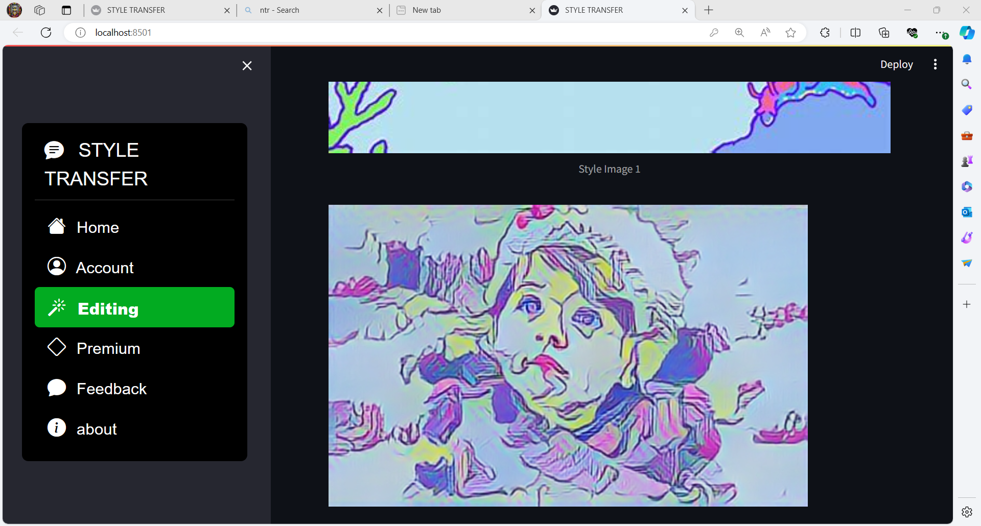

Slide 16
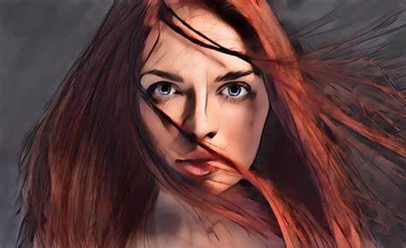

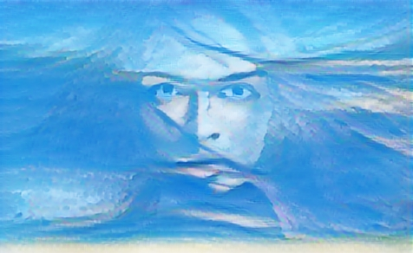
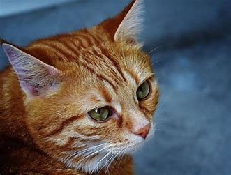

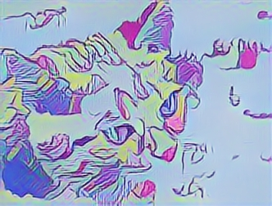

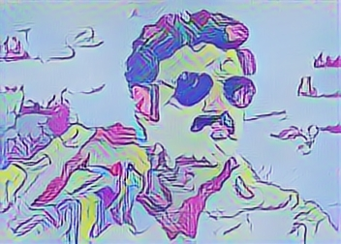
Some Stylished images
+
+
+

Slide 17
PSEUDO CODE
Load pre-trained style transfer model
Load content image
Load style image
Optimize the generated image
Display the final stylized image

Slide 18
THANK YOU

